Slide 1
Lecture 1
Fundamentals of Image Processing (image acquisition and representation)

Slide 2
Fundamentals of Image Processing
Image processing: Image processing is the process of transforming an image into a digital form and performing certain operations to get some useful information from it.

Slide 3
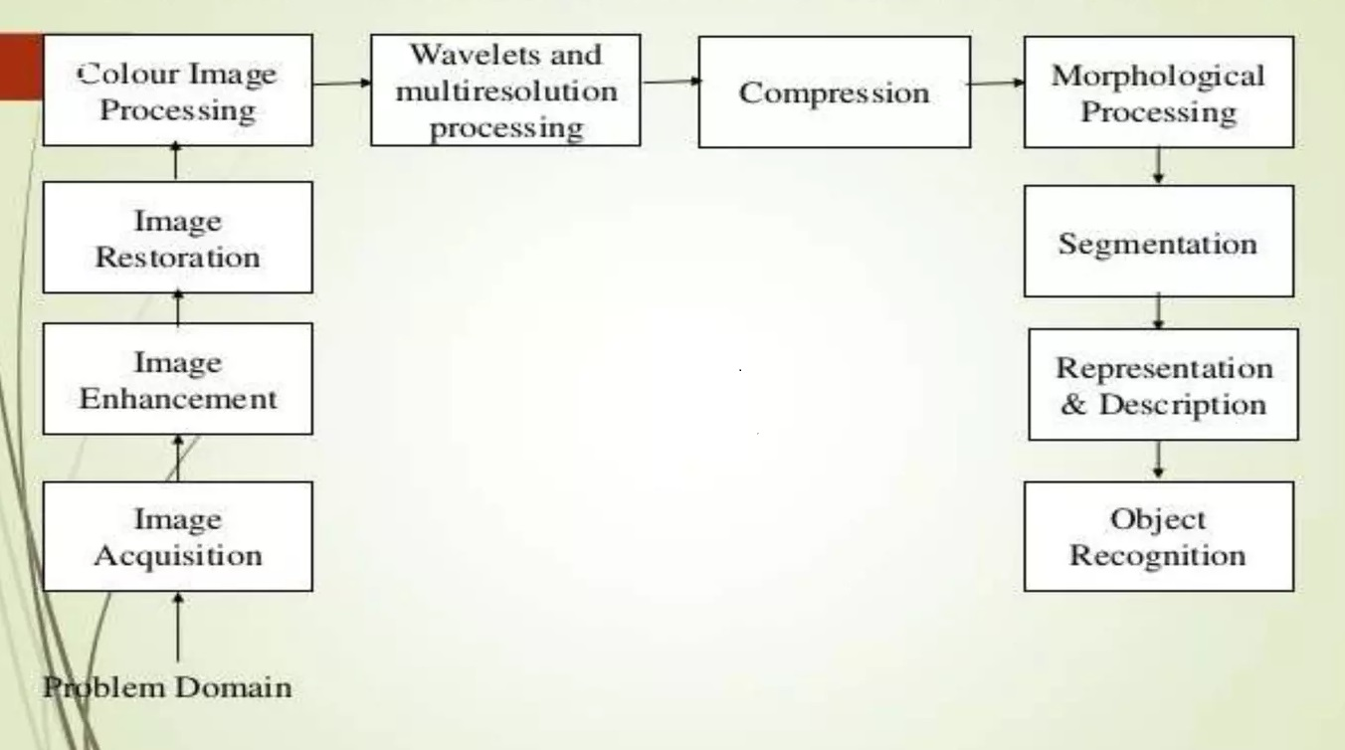
Various Fundamentals of image processing

Slide 4
Image Acquisition
Image acquisition is the first step in image processing. This step is also known as preprocessing in image processing. It involves retrieving the image from a source, usually a hardware-based source.
Image Enhancement
Image enhancement is the process of bringing out and highlighting certain features of interest in an image. This can involve changing the brightness, contrast, etc.
Image Restoration
Image restoration is the process of improving the appearance of an image. However, unlike image enhancement, image restoration is done using certain mathematical or probabilistic models.
Color Image Processing
Color image processing includes a number of color modeling techniques in a digital domain. This step has gained prominence due to the significant use of digital images over the internet.

Slide 5
Wavelets and Multi-resolution Processing
Wavelets are used to represent images in various degrees of resolution. The images are subdivided into wavelets or smaller regions for data compression and for pyramidal representation.
Compression
Compression is a process used to reduce the storage required to save an image or the bandwidth required to transmit it. This is done particularly when the image is for use on the Internet.
Morphological Processing
Morphological processing is a set of processing operations for morphing images based on their shapes.
Segmentation
Segmentation is one of the most difficult steps of image processing. It involves partitioning an image into multiple parts or regions based on characteristics of the pixels in the image.

Slide 6
Image Acquisition and representation
Image Acquisition:
Image acquisition refers to the process of capturing visual data from the real world using imaging devices such as cameras, scanners, or sensors.
The goal is to convert the continuous variations in light intensity across a scene into digital data that can be processed by a computer.
The quality of image acquisition depends on several factors, including the type of imaging device, the resolution (number of pixels), the sensitivity to light, and the presence of noise.

Slide 7
Imaging Principles
Perspective Projection
Parallel Projection

Slide 8
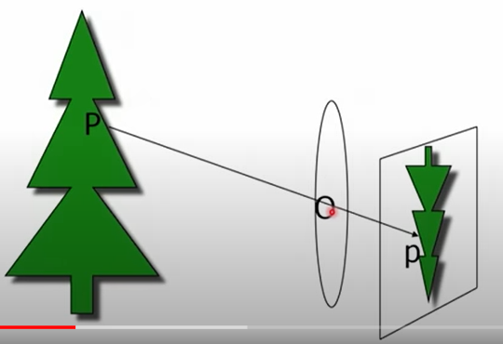
Perspective Projection
The process of perspective projection mimics how the human eye perceives depth and distance, creating a realistic sense of spatial depth in the 2D representation.
In Perspective Projection the center of projection is at finite distance from projection plane.
This projection produces realistic views but does not preserve relative proportions of an object dimensions.
Projections of distant object are smaller than projections of objects of same size that are closer to projection plane. This phenomenon is known as foreshortening.

Slide 9
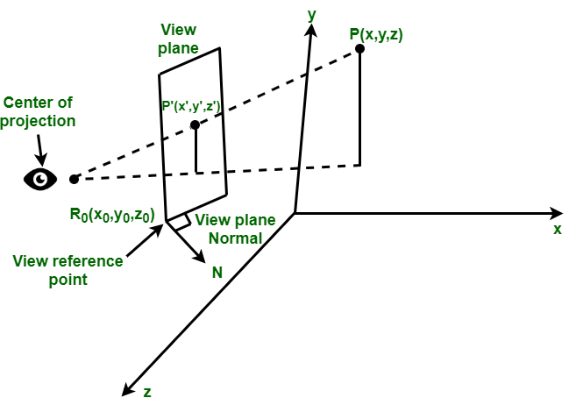
Perspective Projection
Center of Projection – It is a point where lines or projection that are not parallel to projection plane appear to meet.
View Plane or Projection Plane – The view plane is determined by :
View reference point R0(x0, y0, z0)
View plane normal.
Location of an Object – It is specified by a point P that is located in world coordinates at (x, y, z) location. The objective of perspective projection is to determine the image point P’ whose coordinates are (x’, y’, z’)

Slide 10
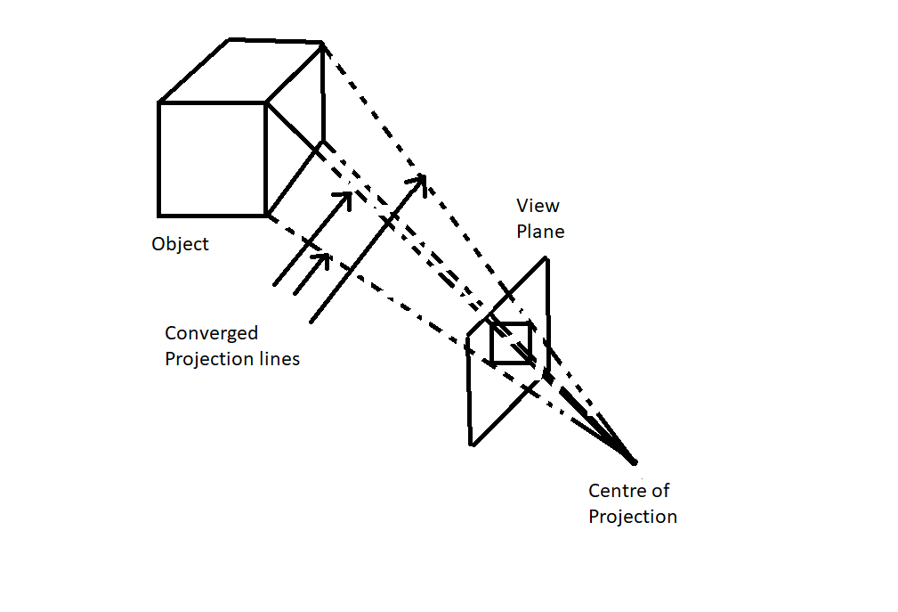
Perspective Projection
In perspective projection, the lines of projection are not parallel. Instead, they all converge at a single point called the center of projection or projection reference point.
The object positions are transformed to the view plane along these converged projection lines and the projected view of an object is determined by calculating the intersection of the converged projection lines with the view plane

Slide 11
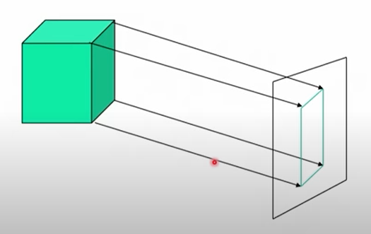
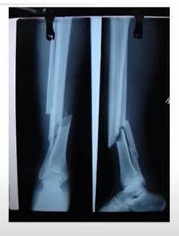
Parallel Projection
Parallel projection is another technique used in computer graphics, engineering drawings, and other applications to represent a three-dimensional (3D) scene on a two-dimensional (2D) surface without the foreshortening effect present in perspective projection.
Unlike perspective projection, parallel projection preserves the relative sizes and shapes of objects regardless of their distance from the viewer.
In parallel projection, parallel lines in the 3D scene remain parallel in the 2D representation. This creates an orthographic projection, where the projection rays from the scene to the 2D image plane are all parallel, resulting in a flat and non-perspective view.

Slide 12
What is an Image?
Impression of the real world.
Spatial distribution of a measurable quantity, encoding the geometry, and material properties of object.

Slide 13
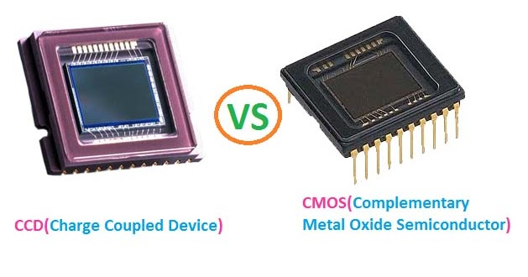
Different imaging devices use various technologies:
such as CCD (Charge-Coupled Device) or CMOS (Complementary Metal-Oxide-Semiconductor) sensors in digital cameras

Slide 14
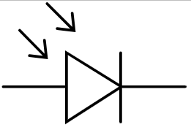
Photodiode Sensor
Photodiode is the most common and basic sensor for image acquisition. It is constructed of silicon materials so that its output voltage is proportional to incoming light.
Photodiodes in scanners, to capture light and convert it into electrical signals. These electrical signals are then digitized to create a digital representation of the image.
Electronic symbol of a photodiode

Slide 15
Quiz Time
1. Which of the following is NOT a common image acquisition device?
a) Digital camera
b) Scanner
c) Microphone
d) Webcam
2. The most familiar single sensor used for Image Acquisition is
a) CCD
b) Photodiode
c) CMOS
d) None of the Mentioned

Slide 16
3. The resolution of an image is primarily determined by:
a) The number of colors in the image
b) The file size of the image
c) The pixel dimensions of the image
d) The format in which the image is saved

Slide 17
Answers
1. Which of the following is NOT a common image acquisition device?
a) Digital camera
b) Scanner
c) Microphone
d) Webcam
2. The most familiar single sensor used for Image Acquisition is
a) CCD
b) Photodiode
c) CMOS
d) None of the Mentioned
3. The resolution of an image is primarily determined by:
a) The number of colors in the image
b) The file size of the image
c) The pixel dimensions of the image
d) The format in which the image is saved

Slide 18
Image Representation
Once the image is acquired and converted into digital form, it needs to be represented in a way that can be processed and analyzed by computers.
There are two primary types of image representations:
Raster (Pixel-based) Representation
Vector Representation

Slide 19
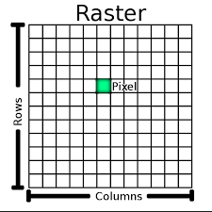

Raster (Pixel-based) Representation:
In raster representation, the image is divided into a grid of pixels, where each pixel corresponds to a specific location in the image and holds information about the color and intensity at that location.
Example: The most common raster image formats include JPEG, PNG, and BMP.

Slide 20
Important facts about Raster Representation:
Raster graphics are bitmaps.
A bitmap is a grid of individual pixels that collectively compose an image.
Raster graphics render images as a collection of countless tiny squares.
Each square, or pixel, is coded in a specific hue or shade.
Individually, these pixels are worthless. Together, they’re worth a thousand words.

Slide 21

Vector Representation:
In vector representation, an image is described using geometric primitives such as lines, curves, and shapes, along with attributes like color and position. Vector representations are resolution-independent and can be scaled without loss of quality.
Example: They are commonly used in computer-aided design (CAD) and graphic design applications.

Slide 22
Quiz Time
Image is described using geometric primitives such as line, curves in:
Polar representation
Raster representation
Vertical representation
Vector representation
Images are constructed through pixels in:
Polar representation
Raster representation
Vertical representation
Vector representation

Slide 23
Important thing to keep in Mind:
Image representation is crucial because it affects the efficiency and accuracy of image processing algorithms.
Depending on the task at hand, different image representations might be more suitable.
For example: Raster representations are better for tasks like image filtering and manipulation, while vector representations are preferred for tasks like logo design or geometric transformations.

Slide 24
Thank you!

